Slide 1
Principal Component Analysis

Slide 2
Principal Component Analysis:
Principal Component Analysis is a dimensionality reduction technique
PCA aims at reducing a large set of variables to a small set of variables to capture the underlying variance of the data without much loss of information.
Principal component analysis is used to extract the important information from a multivariate data table and to express this information as a set of few new variables called principal components.
These new variables correspond to a linear combination of the originals. The number of principal components is less than or equal to the number of original variables.
If The original data set has P variables(Dimensions),the transformed data set has M variables(dimensions)
Then----> M<=P

Slide 3
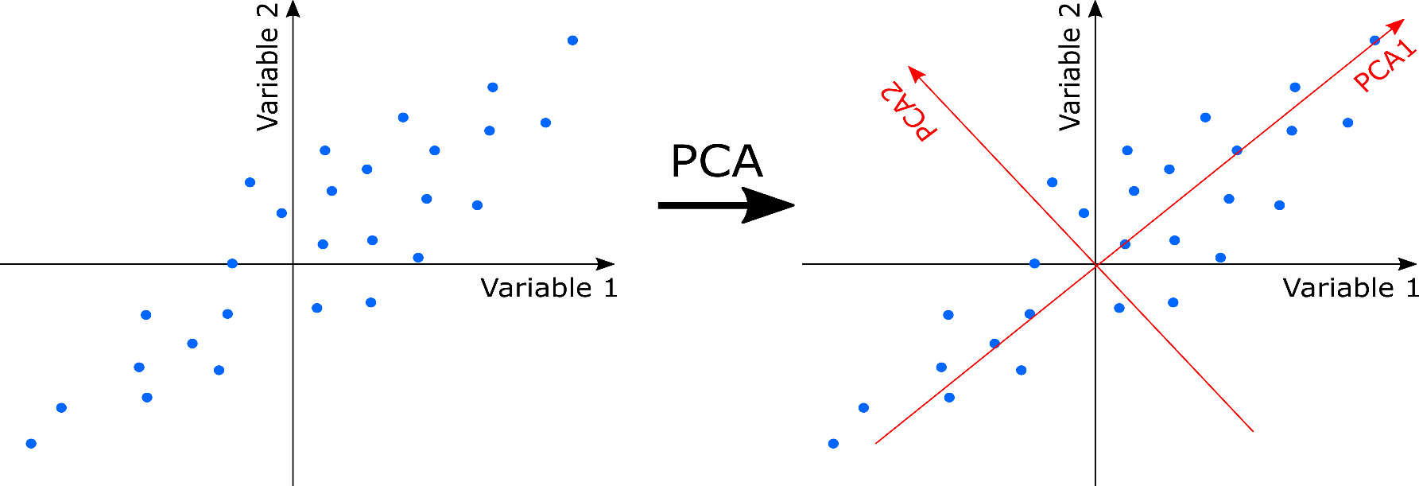
Why PCA:
Do you want to reduce the number of variables, but aren’t able to identify variables to completely remove from consideration?
Do you want to ensure your variables are independent of one another?
To avoid Multicollinearity between variables
To avoid Curse of Dimensionality
Then PCA is good option

Slide 4
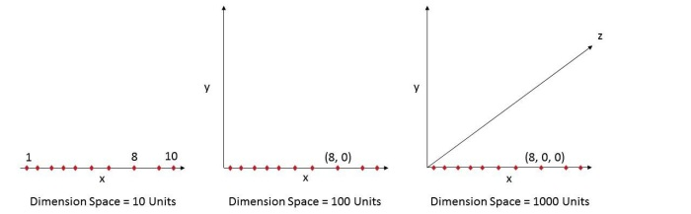
Curse of Dimensionality:
As the number of features or dimensions grows, the amount of data we need to generalize accurately grows exponentially."
- Charles Isbell, Professor and Senior Associate Dean, School of Interactive Computing, Georgia Tech
This exponential growth in data causes high sparsity in the data set and unnecessarily increases storage space and processing time for the modelling algorithm.
Think of image recognition problem of high-resolution images 1280 × 720 = 921,600 pixels i.e. 921600 dimensions. OMG. And that’s why it’s called Curse of Dimensionality.

Slide 5
Always observe the orthogonality between Dimensions(Variables)
How to Find Pc’s:
Principle components are the eigenvectors of the covariance matrix.
Before we talk more about PCA there are few important topics we have to know
What is Covariance matrix
What is Eigenvalues & Eigenvectors

Slide 6
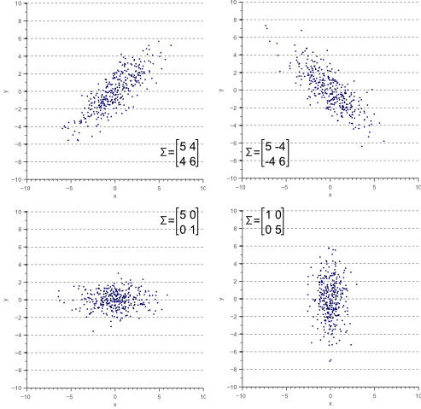
Covariance:
Covariance is the measure of how two different variables change together
cov(x,y)=E([x−E(x)][y−E(y)])
Representing Covariance between dimensions as a matrix e.g. for 3 dimensions:
cov(x,x) cov(x,y) cov(x,z)
C = cov(y,x) cov(y,y) cov(y,z)
cov(z,x) cov(z,y) cov(z,z)
N-dimensional data will result in nxn covariance matrix
Covariance: measures the correlation between X and Y
Cov(X,Y)=0: independent
Cov(X,Y)>0: move same direction
Cov(X,Y)<0: move opposite direction
No covariance means dimensions are orthogonal

Slide 7
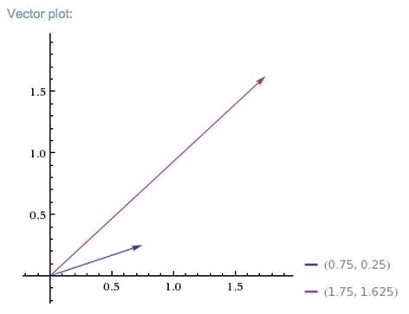
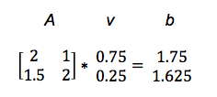
Eigenvalues and Eigenvectors:
The eigen in eigenvector comes from German, and it means something like “very own.” For example, in German, “mein eigenes Auto” means “my very own car.” So eigen denotes a special relationship between two things. Something particular, characteristic and definitive. This car, or this vector, is mine and not someone else’s.
Matrices, in linear algebra, are simply rectangular arrays of numbers, a collection of scalar values between brackets, like a spreadsheet. All square matrices (e.g. 2 x 2 or 3 x 3) have eigenvectors, and they have a very special relationship with them, a bit like Germans have with their cars.
Linear Transformations:
We’ll define that relationship after a brief detour into what matrices do, and how they relate to other numbers.
Matrices are useful because you can do things with them like add and multiply. If you multiply a vector v by a matrix A, you get another vector b, and you could say that the matrix performed a linear transformation on the input vector.
Av = b

Slide 8

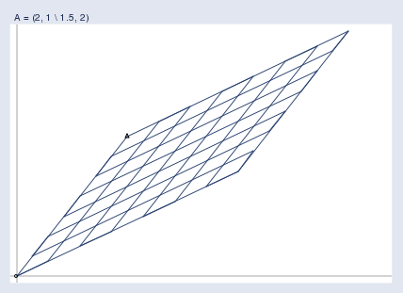

Imagine that all the input vectors v live in a normal grid, like this:
And the matrix projects them all into a new space like the one below, which holds the output vectors b:
Refer: Skymind article

Slide 9
So covariance matrix is rectangular matrix i.e with order 2x2,3x3,4x4,….etc
So each matrix has eigen vectors of its order i.e 2x2 matrix has 2 eigen vectors
An eigenvector was the direction of the line (vertical, horizontal, 45 degrees , 30 degrees ..etc.)
Eigenvectors and values exist in pairs: every eigenvector has a corresponding eigenvalue
An eigenvalue is a number, telling you how much variance there is in the data in that direction
The eigenvalues explain the variance of the data along the new feature axes.
The eigenvector with the highest eigenvalue is therefore the principal component.
Assume that we have data with variables Age,Gender,Education
Original dim
Transformed dim
Pc1=a1*Age+b2*Gender+c3*Education
Pc2=a2*Age+b2*Gender+c2*Education
Pc3=a3*Age+b3*Gender+c3*Education
var(Pc1)>var(pc2)>var(pc3)
We have 3 dimensions i.e Age, Gender, Education

Slide 10
What Are Principal Components?
The principal components produces a linear combinations or dimensions of the data that are really high in variance and that are uncorrelated
When two variables are really correlated with each other, one new variable (ie the first principle component) can really summarize both of those two variables very well
The variables with unusually large variances will get selected.
Question:
What are the eigenvectors of matrix whose covariance are zero i.e orthogonal dimensions?

Slide 11
PC1&PC2:
First Principal component : Linear combination of original predictor variables which captures the maximum variance in the data set. Larger the variability captured in first component
Second principal component: is also a linear combination of original predictors which captures the remaining variance in the data set and is uncorrelated with first PC.
No other component can have variability higher than first principal component. The direction along which there is greatest variation

Slide 12
STEPS FOR PCA:
1.Standardize the data.
Perform PCA after scaling, i.e. z-scoring for each variable. Original predictors may have different scales.
Standardization" (or "scaling") within variables will express each observation relative to its position in the distribution for that variable.
Performing PCA on un-scaled variables will lead to large loadings for variables with high variance.
2.Calculate the covariance matrix.
A correlation matrix is like a covariance matrix but first the columns have been standardized. This means the matrix should be numeric and have standardized data.

Slide 13
3.Find the eigenvectors of the covariance matrix.
To convert the data into the new axes, we will multiply the original variable data by eigenvectors, which indicate the direction of the new axes (principal components).
Each eigenvector will correspond to an eigenvalue, whose magnitude indicates how much of the data’s variability is explained by its eigenvector.
Covariance Matrix * Eigenvector = eigenvalue * eigenvector
4.Translate the data to be in terms of the components.
Since the eigenvectors indicates the direction of the principal components (new axes), we will multiply the original data by the eigenvectors to re-orient our data onto the new axes. This re-oriented data is called a score.
original data * eigenvectors

Slide 14
Omkar N

